Slide 1

Portfolio Website
By Nhan Dang

Slide 2

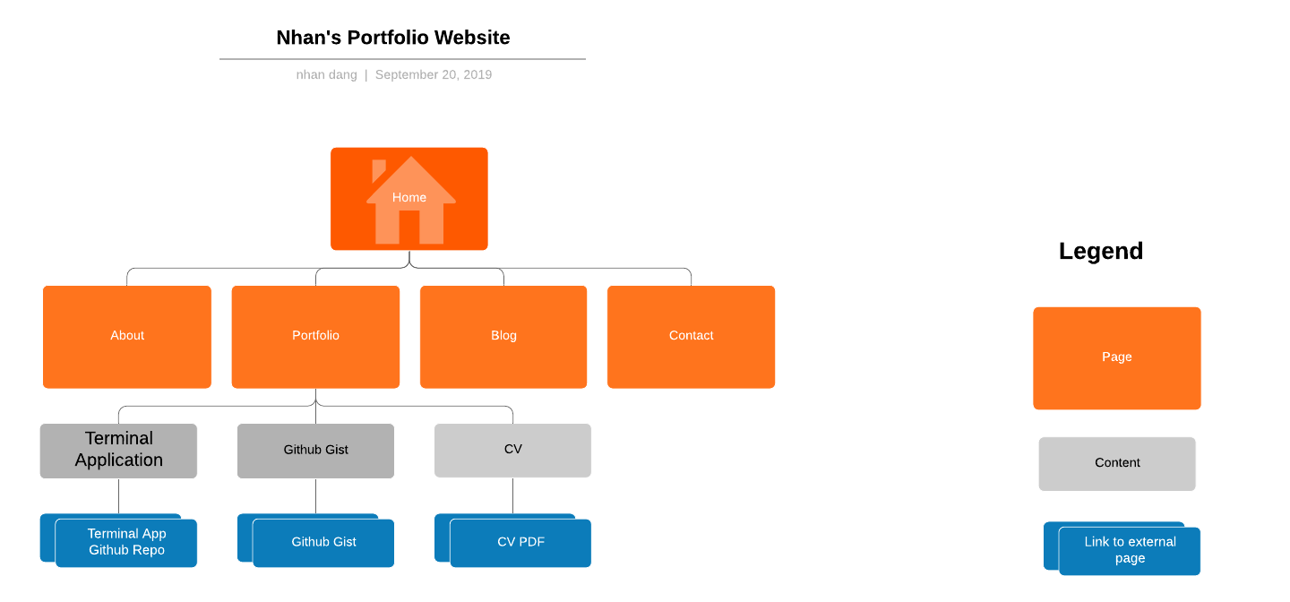
Sitemap
Notes:
My site will have 5 pages in total. I wanted to keep it simple and due to time constraints refrained from making any more pages.

Slide 3

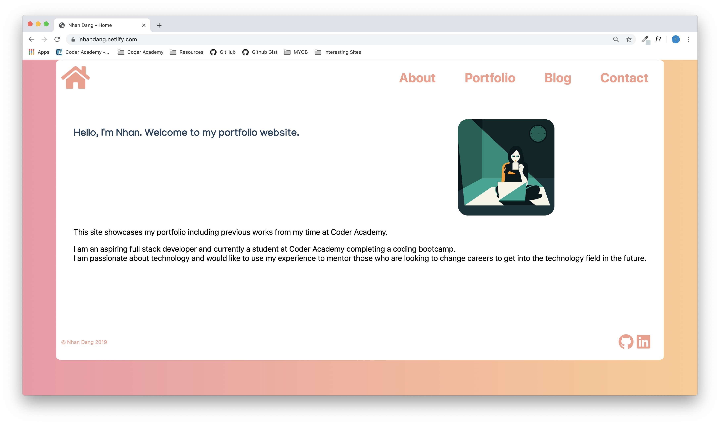
My Website
https://nhandang.netlify.com/index.html
Notes:
Show: Navbar, footer, walk through each page

Slide 4
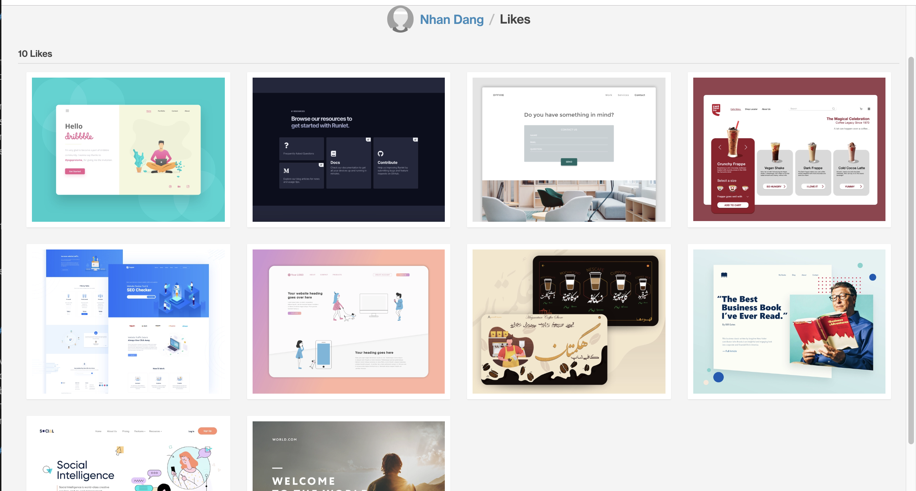
Design Process
Browse Dribble for some inspiration
Different designs for each page
Find a colour theme using Coolers
Find suitable fonts using Google Fonts
Headers
Body
Notes:
I want a simple design with a white background as I like minimalistic designs.
I always found websites with images appealing so I was after that sort of look.
Also kept in mind the limitations of my ability so as I was browsing through dribble I thougth about the type of coding that would be required and if it was achievable.

Slide 5
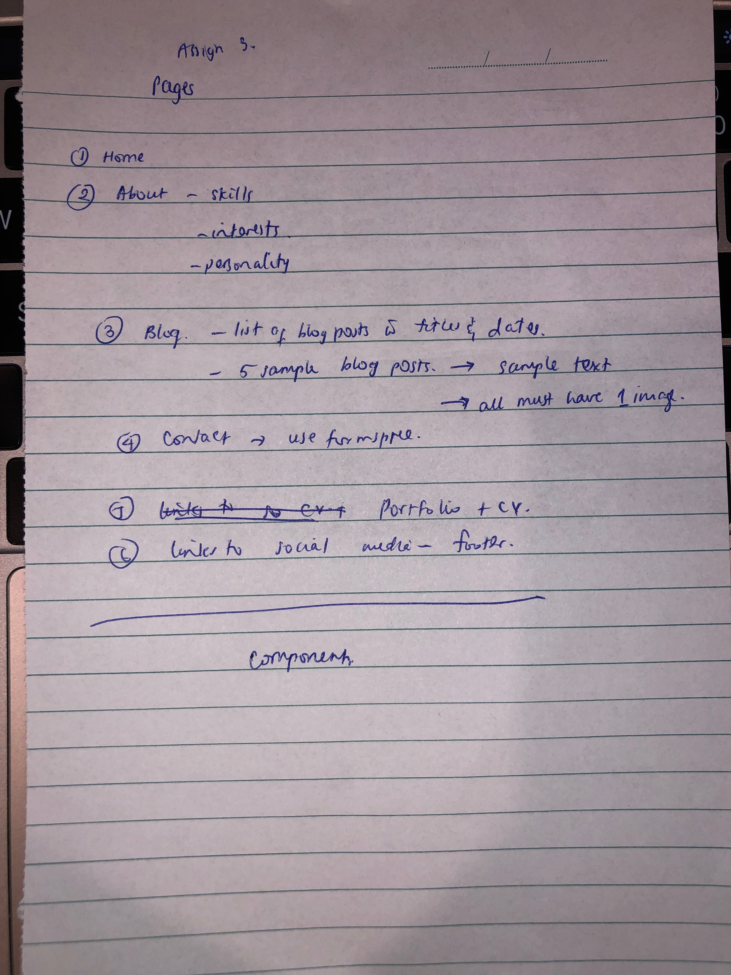
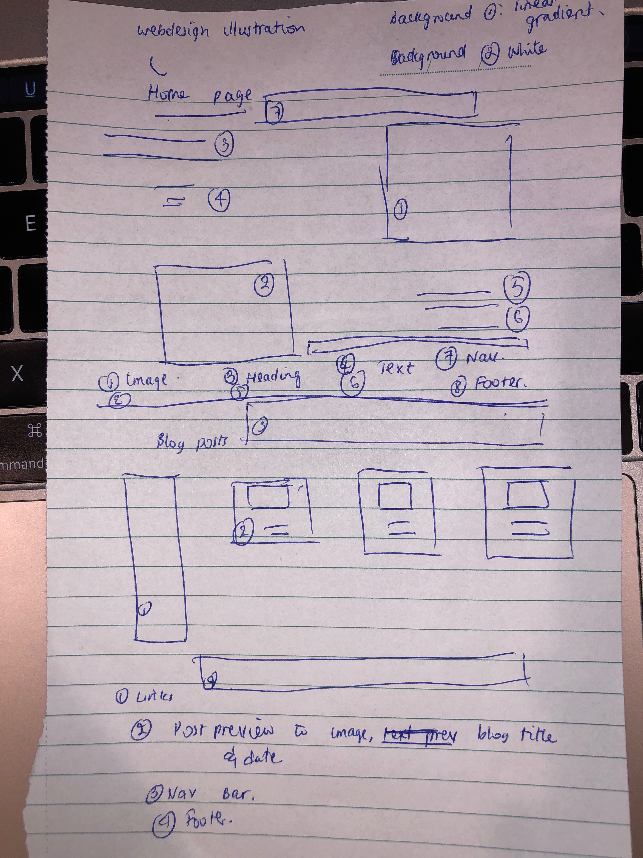
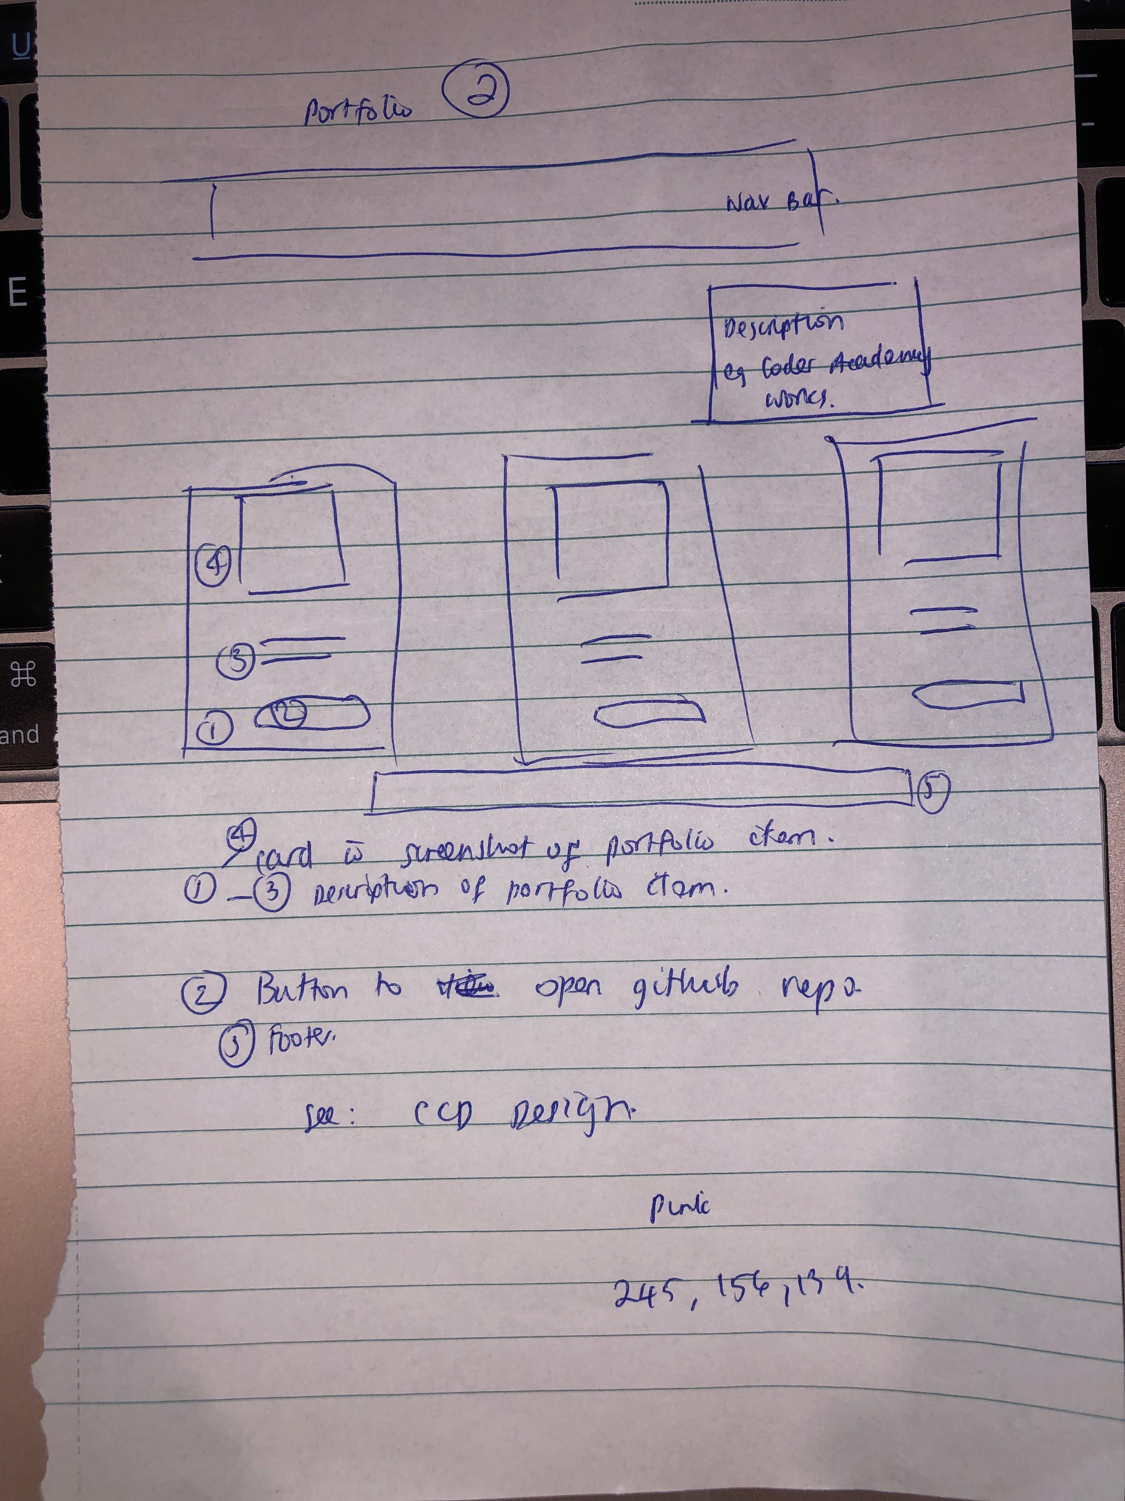
Design Process
Write down pages required
Basic structure
Contents
Draw wireframes on paper based on designs that I liked on Dribbble

Slide 6
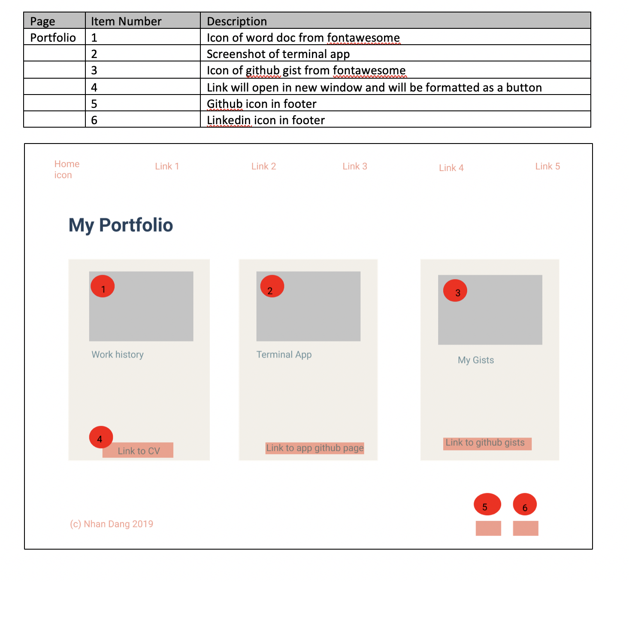
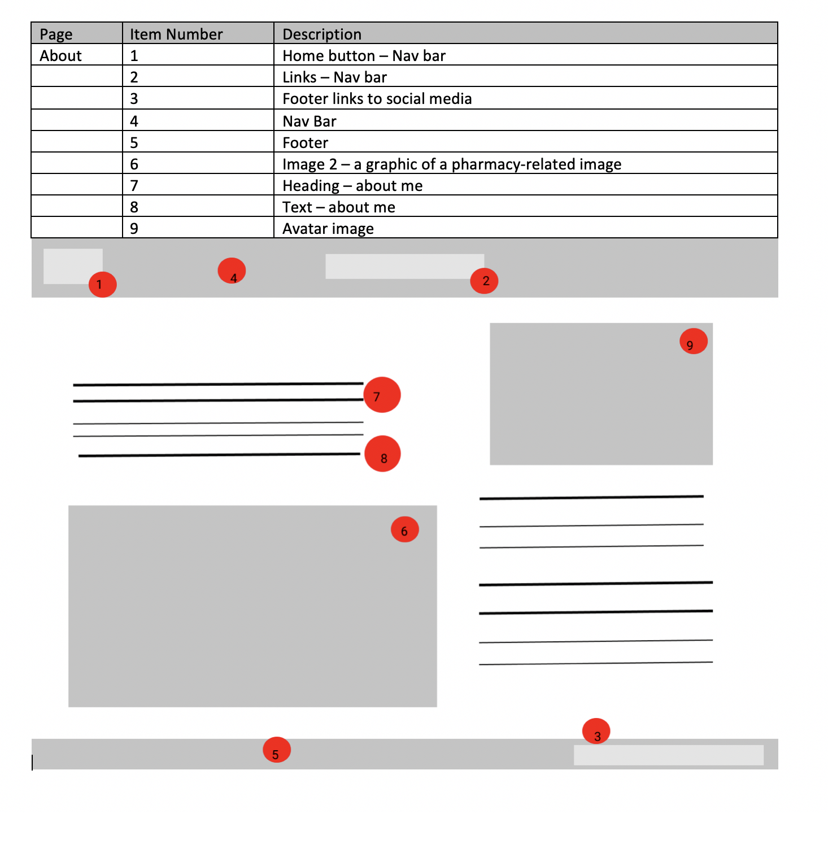
Design Process
Transfer wireframes draw on paper to Figma
Notes:
I built the wireframes and mock ups first to have something to work off
The mock ups were really helpful as I was basically converting the design in my head to something tangible
The mock up process helped me see if my colour theme and design was working as expected
While doing the wireframes and mock ups I was thinking about:
how I was going to code these up
What components do I need to make
what I had to do e.g. grid, flexbox, cards, buttons

Slide 7
Component List
Navigation Bar - Top
Footer - Bottom
Submit Button for contact form
Home button
Link button for portfolio items
Cards for portfolio items
Contact form
Cards for blog posts
Sidebar for links to blog posts

Slide 8
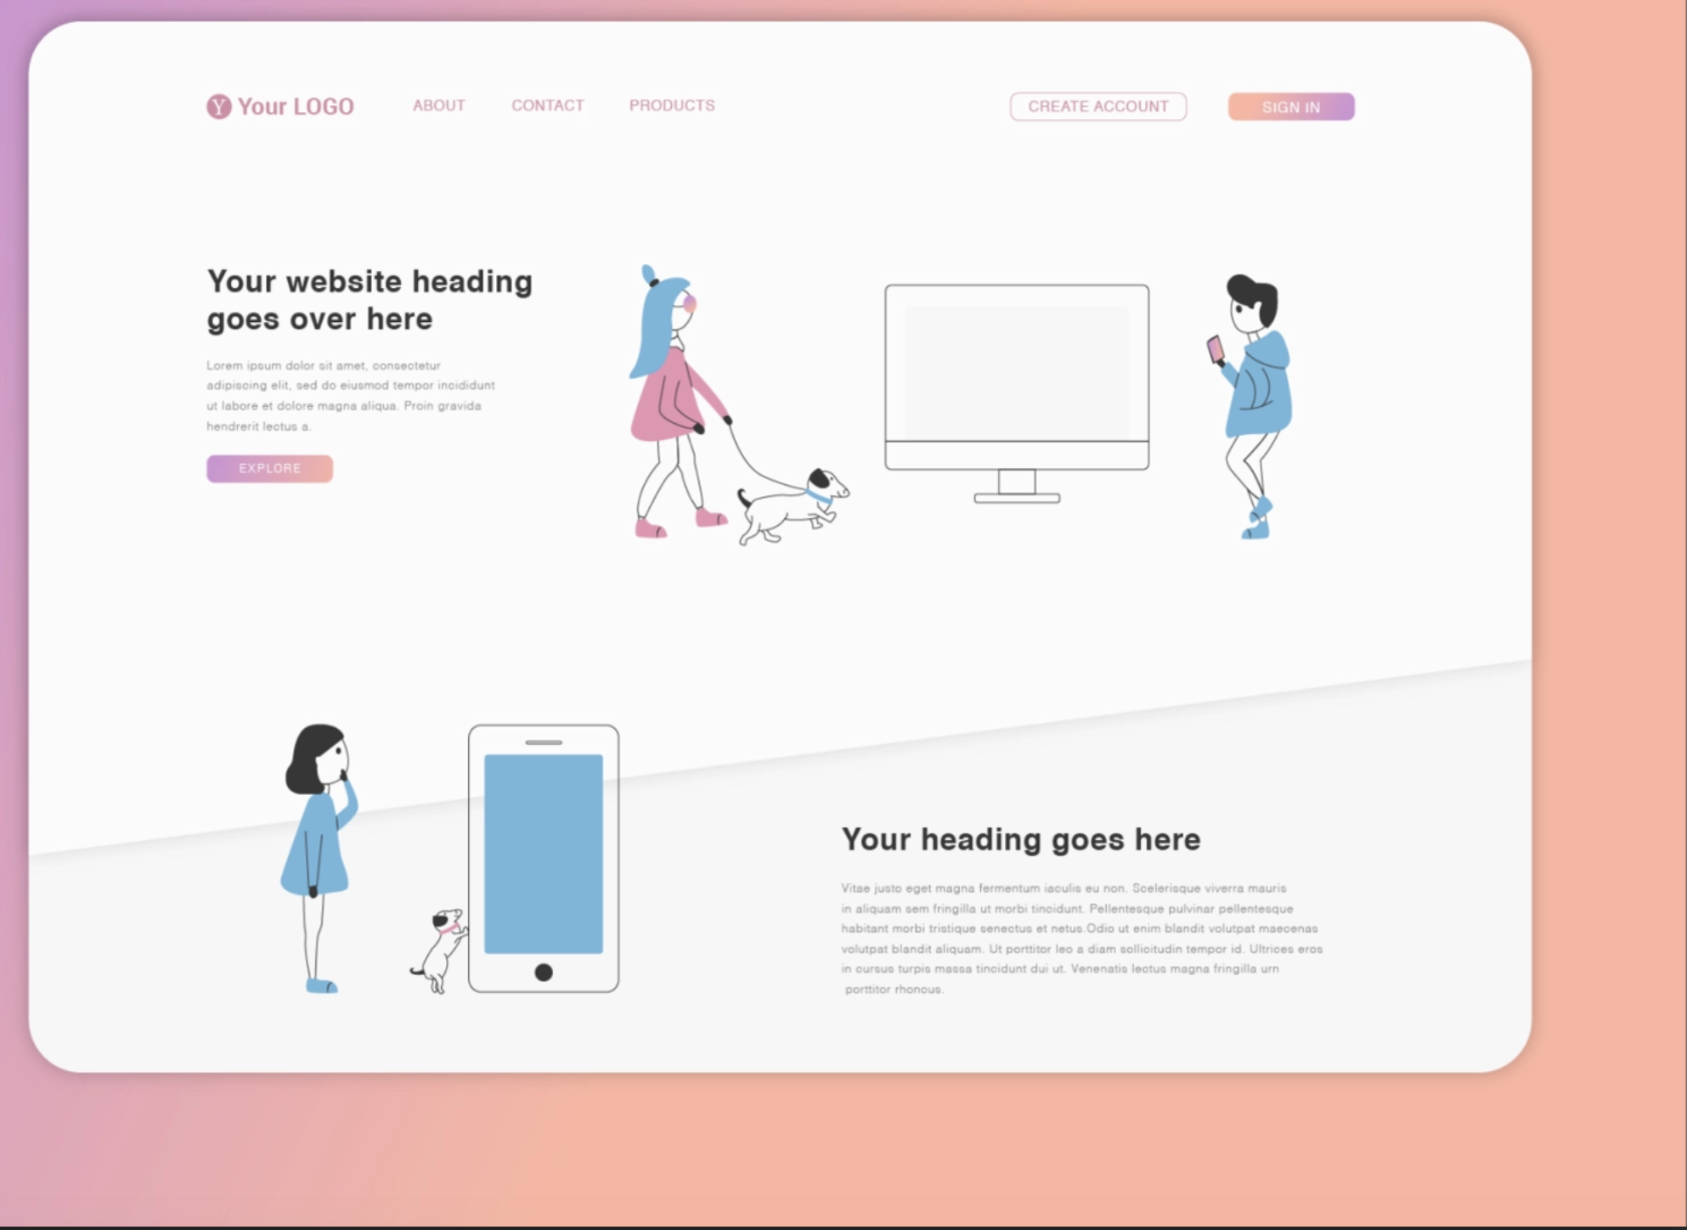
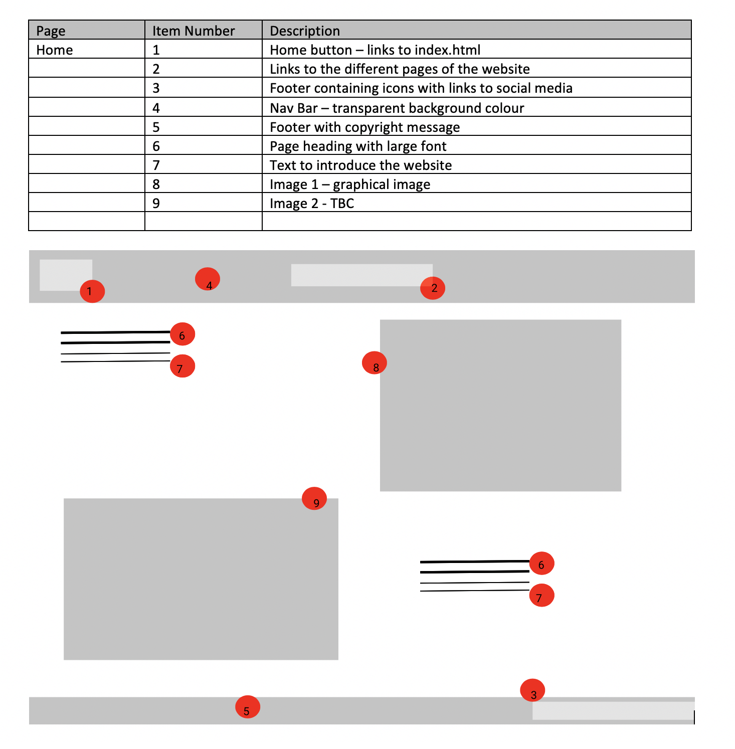
Page Inspirations – Home & About
Notes:
My home page and about page were inspired by this layout. I wanted two pics for my home page but found searching for a suitable image to be too time consuming so reduced it down to one in the final product.

Slide 9
Portfolio
Notes:
From the sample websites Harrison showed us I liked the use of cards in the portfolio pages

Slide 10
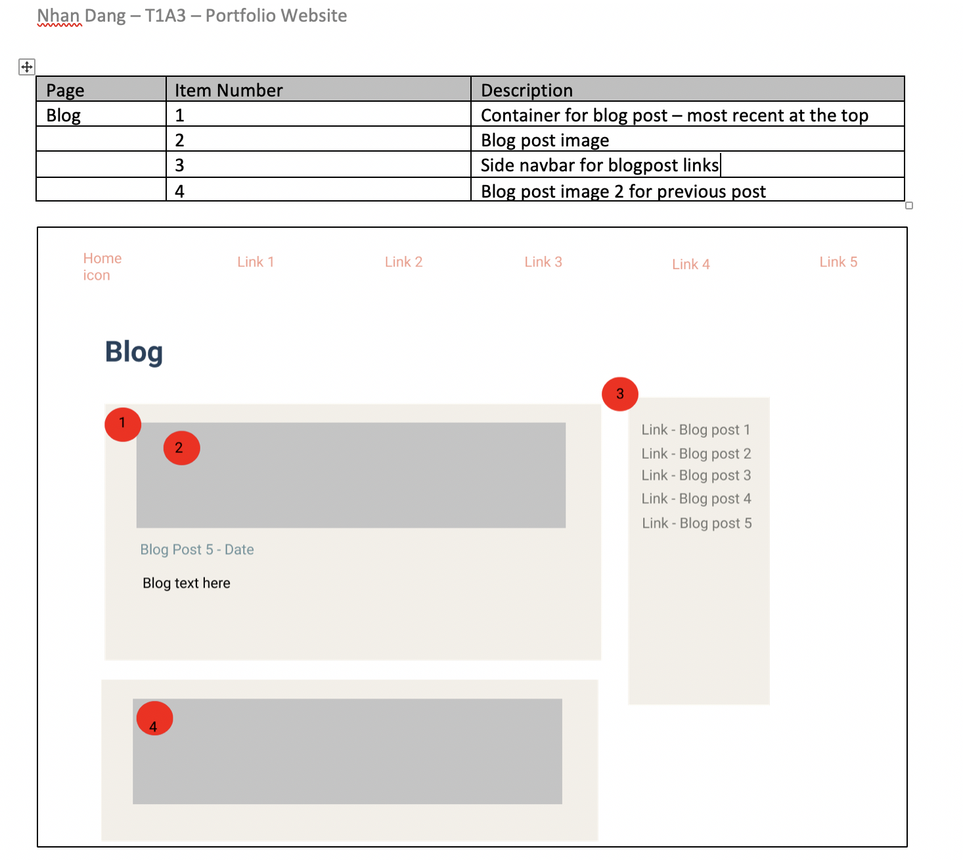
Blog
Notes:
I wanted each post to have its own container and a sidebar to the right containing all the links like the typical blog layout that I’ve seen on different websites

Slide 11
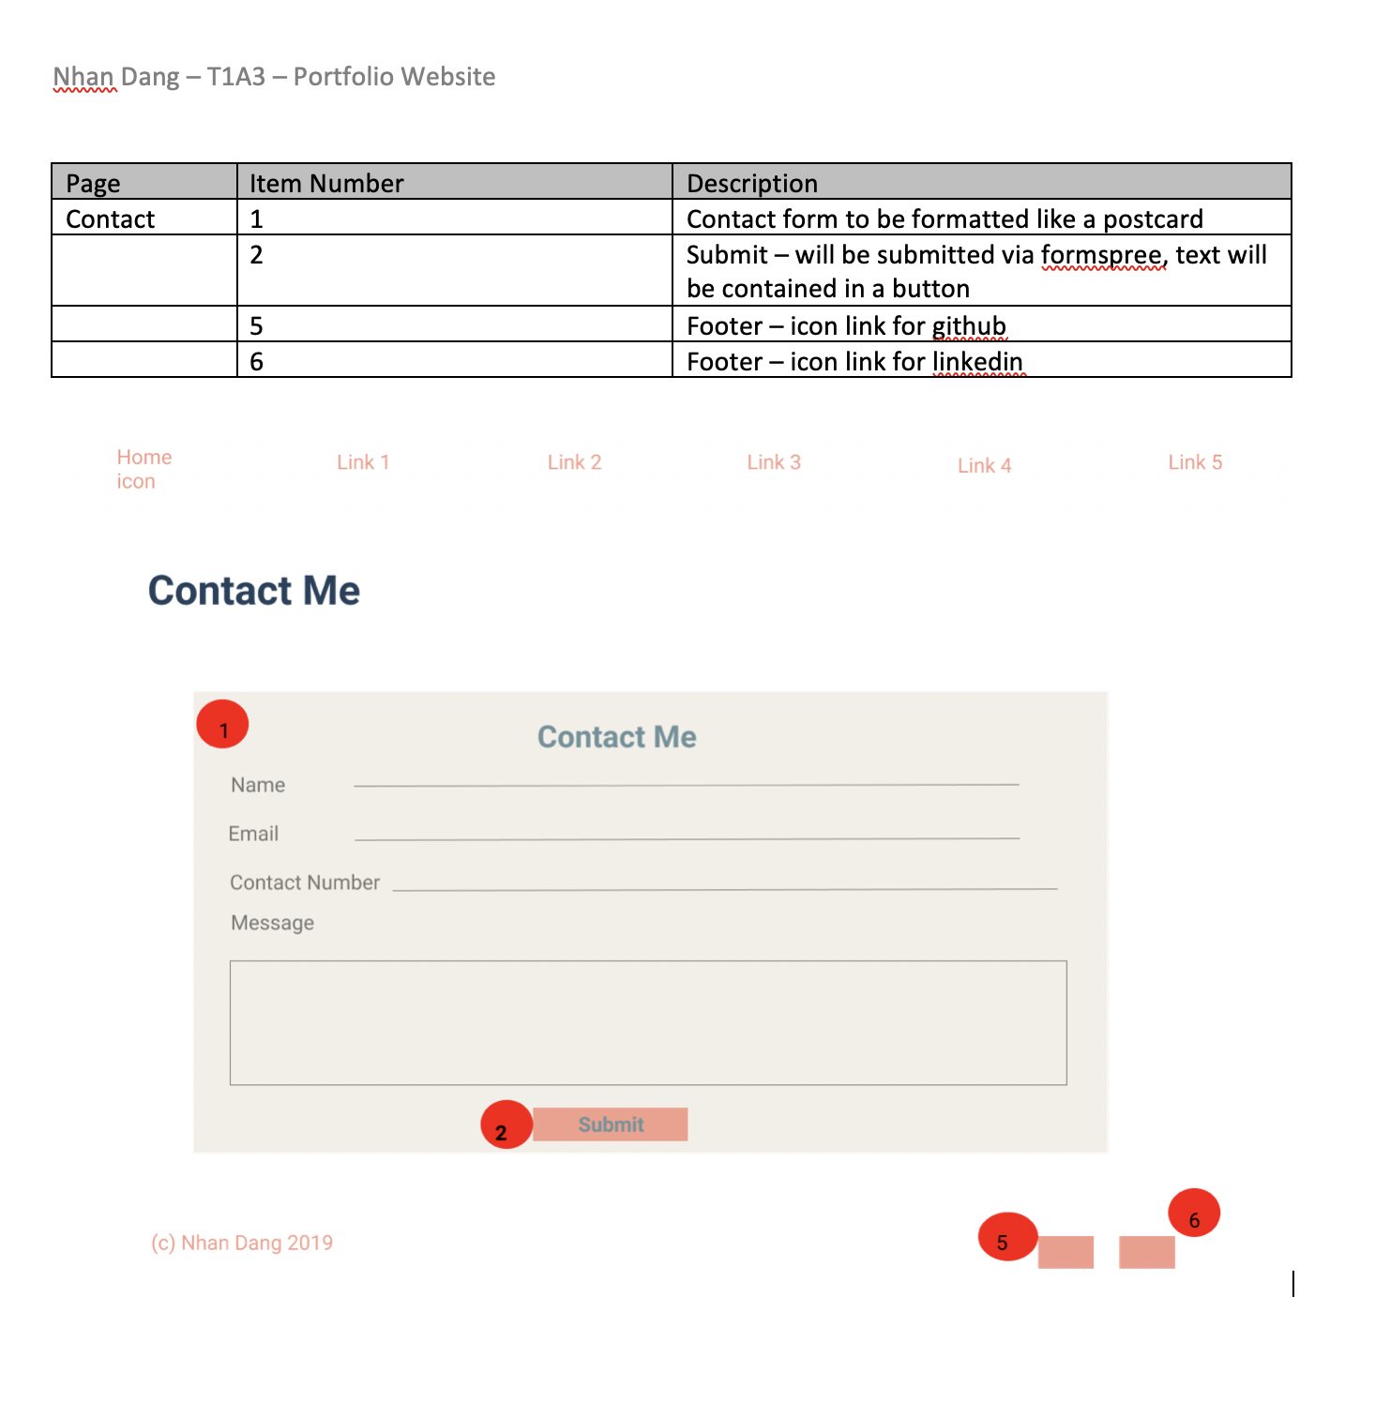
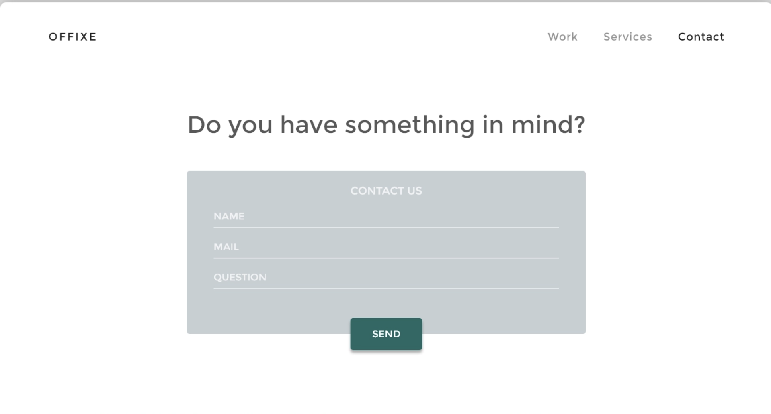
Contact Form
Notes:
I liked the look of a contact form I saw on dribble so that was my inspiration

Slide 12
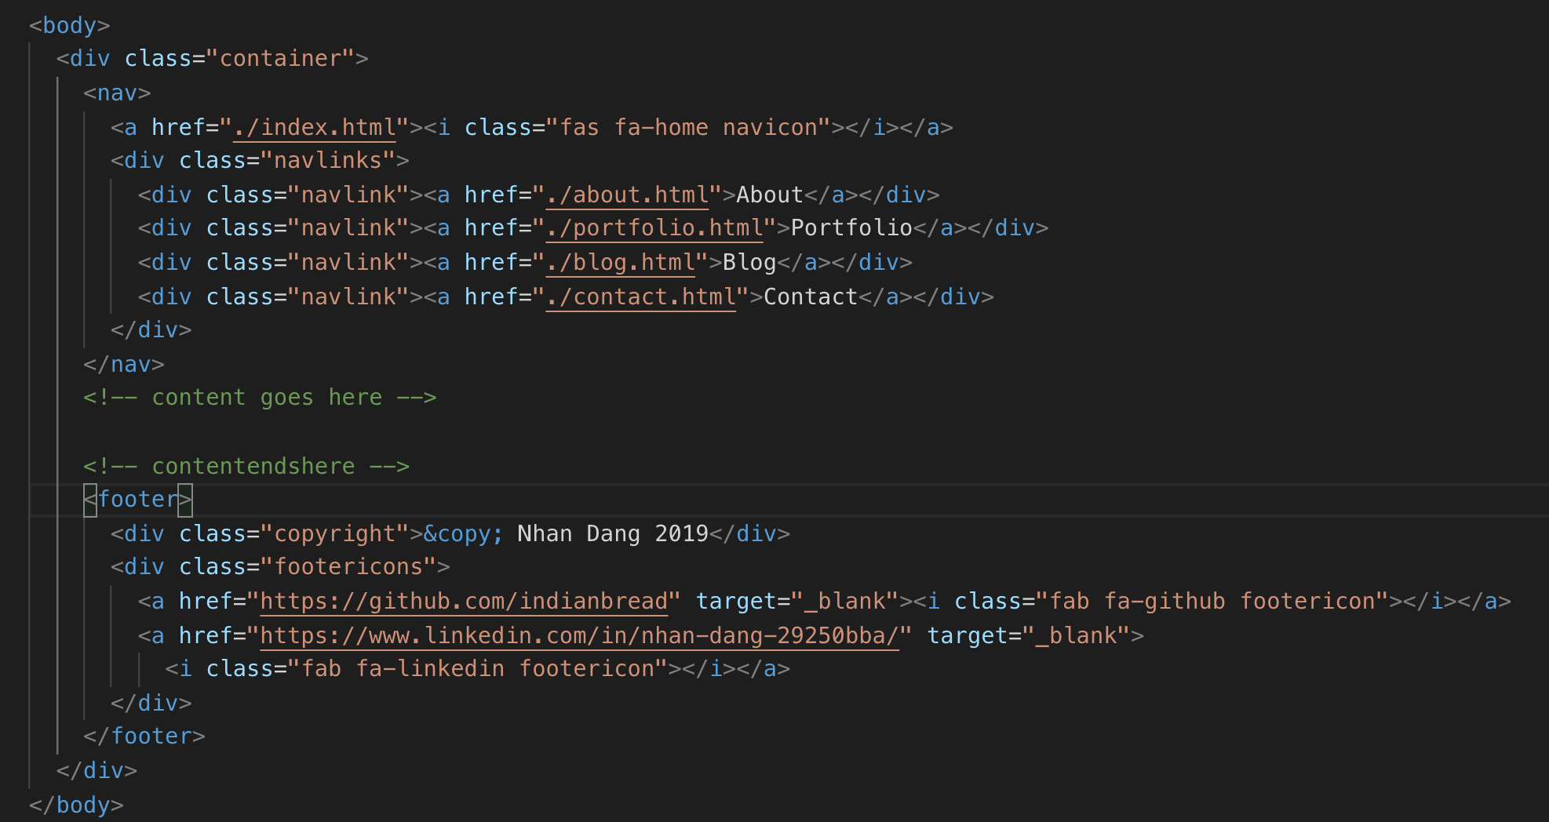
Development Process
Code up a template page based on the wireframes and mock ups
HTML and CSS done in tandem
Separated the template page based on components then put them all together
Added a comment for content start/stop
Copy and paste template contents into every new page, then insert contents in between header and footer
Notes:
I found coding up the html and css simultaneously was the best process for me as I can see what the design looks like as I go and make the adjustments accordingly

Slide 13
Template Components
Navigation Bar
Sourced an icon for the home button from Fontawesome
Didn’t think to make the navigation bar fixed until I had finished the entire website!
Footer
Links to Github and LinkedIn using Fontawesome icons

Slide 14
Master Container
Used a grid to separate the body into 3 columns and 1 row
Allow the background colour to show either side to make the page look less plain
Set the middle column to display as a flexbox to contain the nav, contents and footer

Slide 15
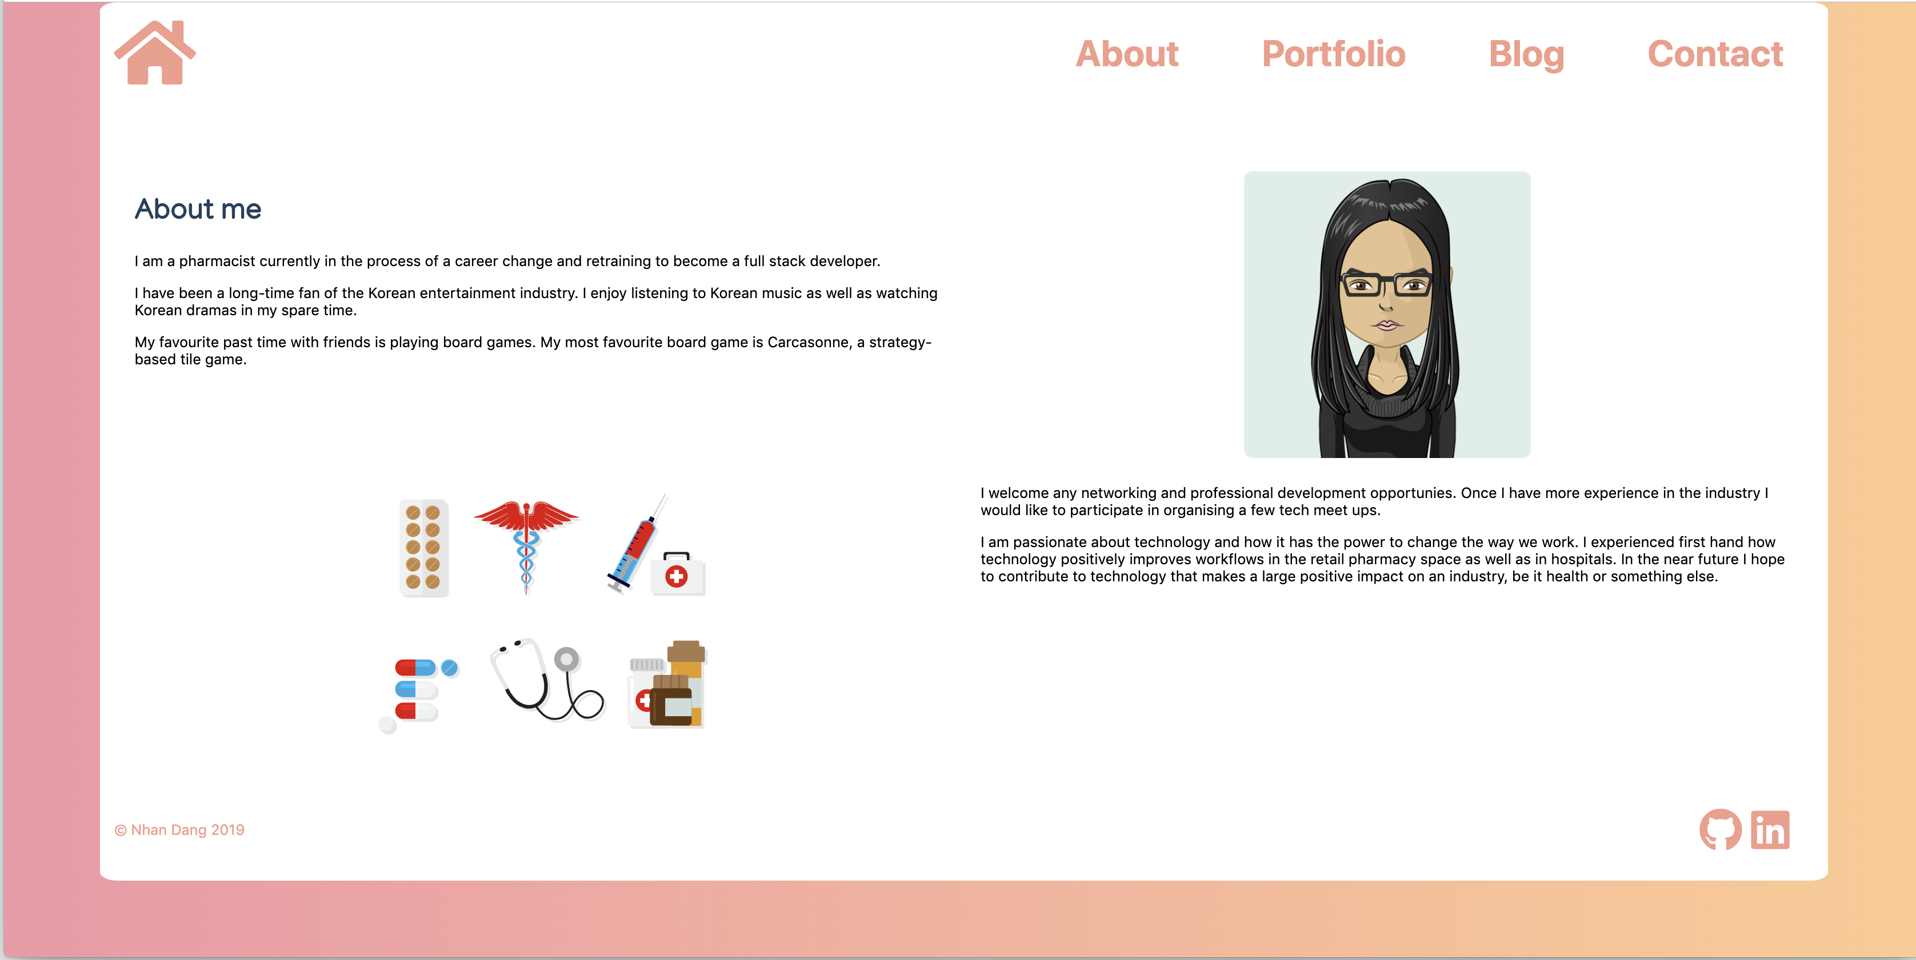
Content Container - Grid
Each page content uses a container that sits between the nav and footer contained in the middle column of the master grid
Display is either flexbox or grid depending on the type of layout the page requires
Master container grid
Content container grid

Slide 16
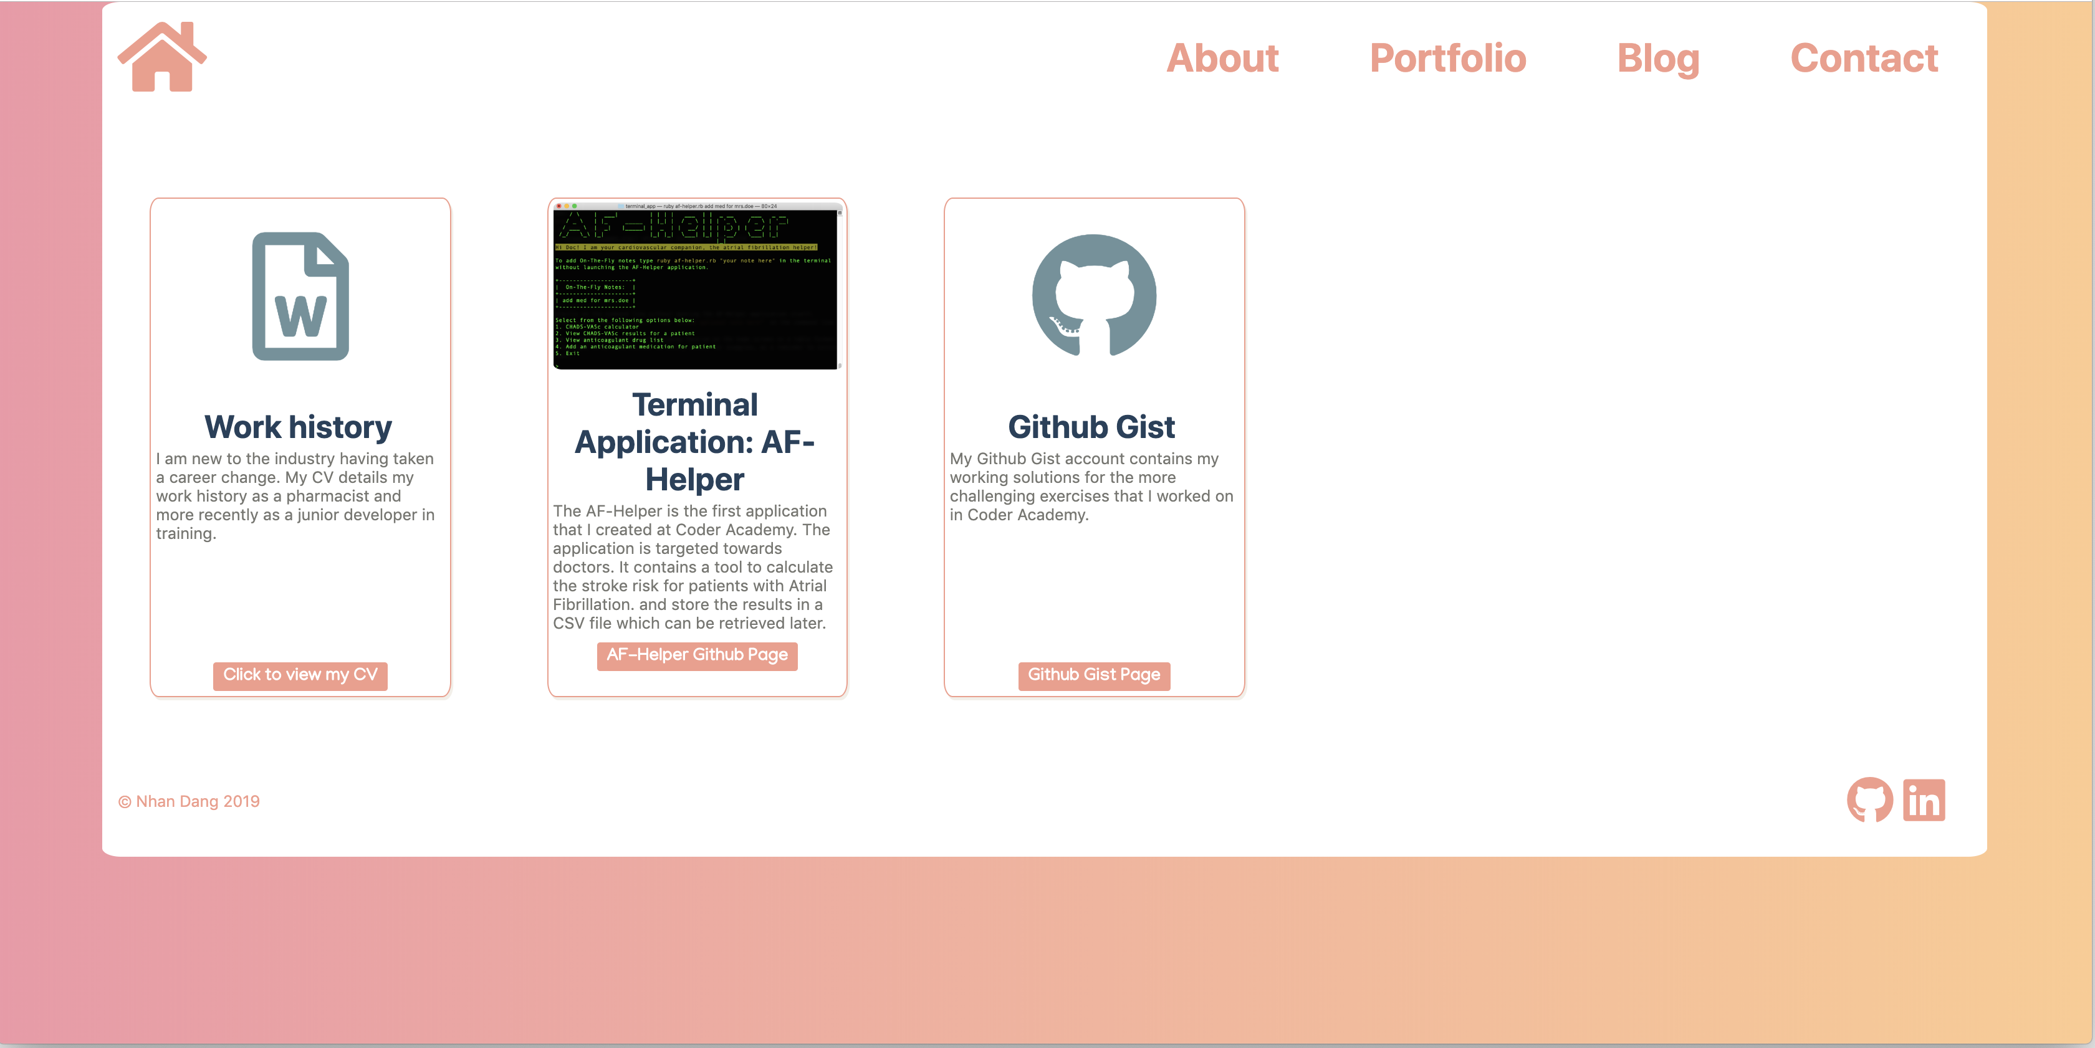
Content Container - Flexbox
Master container grid
Content container flexbox

Slide 17
Challenges
Notes:
I tested the site on my phone after deployment and saw that the navigation bar was in the middle of the page
Realized the layout did not render properly in safari
Changed to flexbox

Slide 18
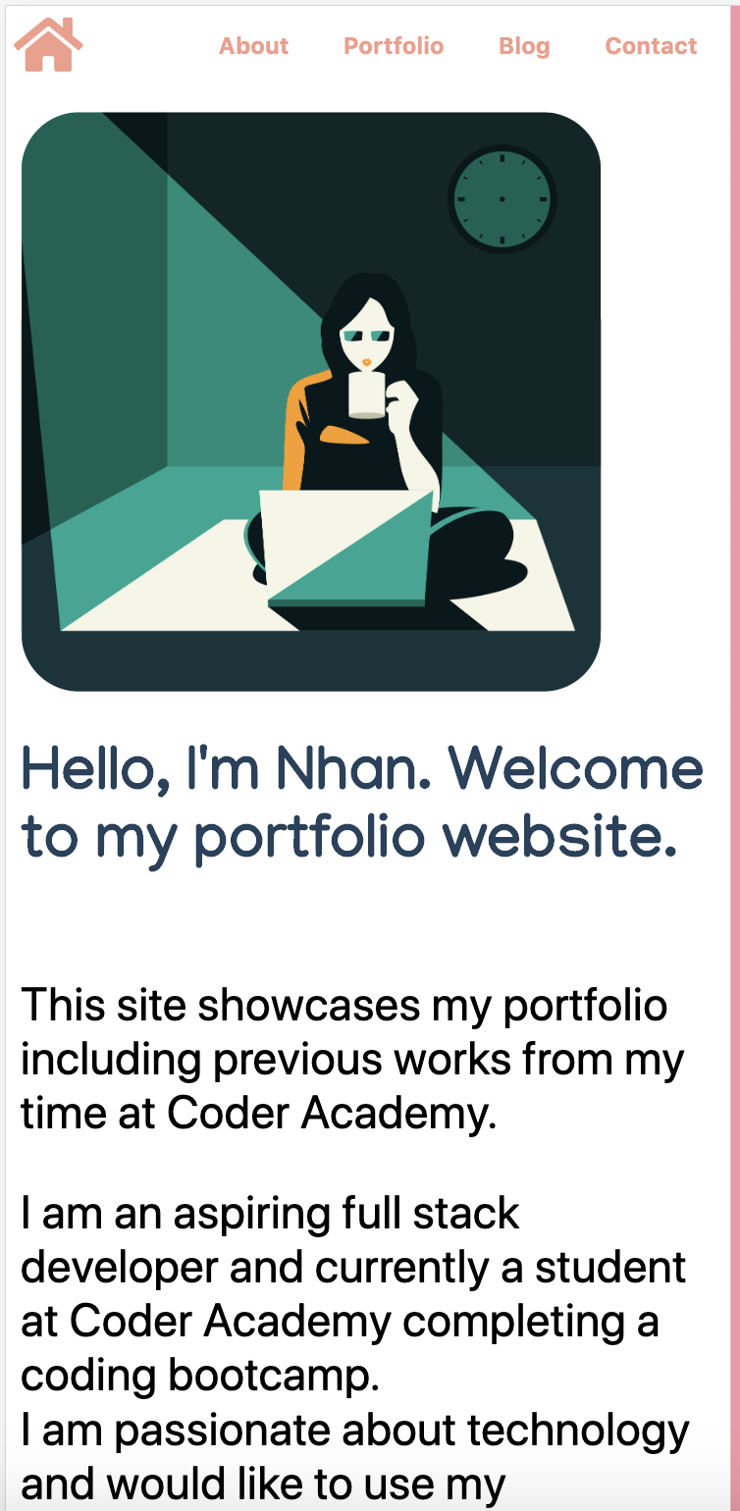
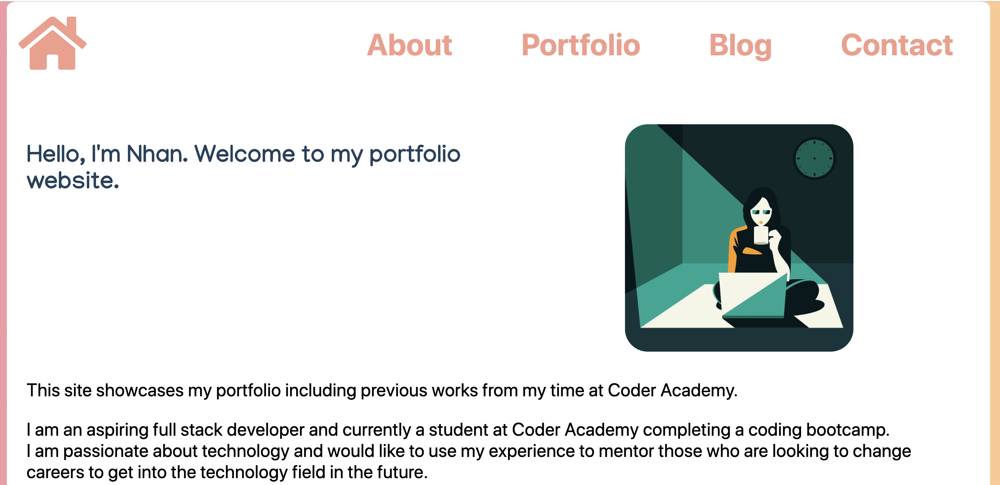
Challenges - Responsiveness
Grid layouts did not render well on smaller screens
Compressed images and content
Content overflows outside of margins
Media queries used to override grid displays and convert them to flexbox displays for smaller screens

Slide 19
Challenges – Image Sizing
Initially used CSS to add the image directly into the allocated grid area
Images did not scale well
Too big on small screens and poor scaling resulting in distortion
Solution:
Add a container for the image
Add a class attribute for the images. Max height specified and width set to ‘auto’ to prevent images from taking up too much room on large screens and distortion when scaling

Slide 20

Challenges - Navigation Bar
Initially use grid
Did not render properly on Safari
Contents on the right hand side overflowed when screen is narrow
Changed to flexbox
Font size not ideal for mobile screens
Media query to shrink font size for smaller screens
Hamburger menu style as an alternate design (branch 2)

Slide 21

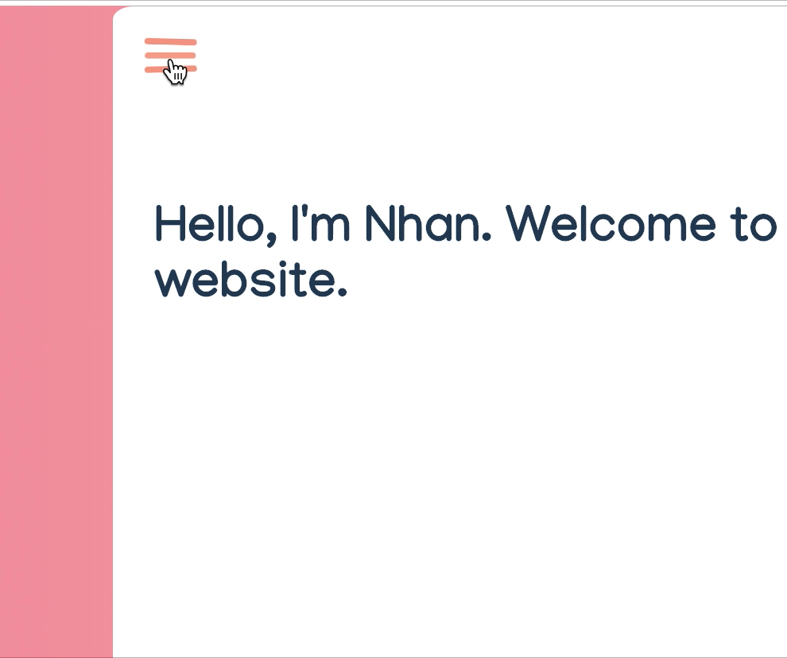
Favourite Parts
CSS Animation on home button
Hamburger Menu
Seeing my final page being responsive!

